Slide 1

Team 5 | Vanilla Systems
Team Leader: Anthony Tortora
Contributor: Henry Ho

Slide 2


Background
Cleaning and Janitorial Services
Company started out in 2020
Struggles to attract new businesses
Lacks in competition with other popular cleaning services
Low Employment rate
Operates in a rudimentary business model that has low growth potential
Notes:
Great Oaks cleaning solution is a company that provides the cleaning and janitorial
services. They specialize in cleaning commercial and government office buildings, post-
construction, and provide floor care and disinfecting services in the DMV area. As of 2020-2021,
Since it is a relatively new company, as of 2020–2021, it has continued to operate without
experiencing a sizable loss or profit. The company has struggled with gaining new business,
being competitive in the market, marketing its brand, and other issues. As a result, the company
has a low client yield. The company has three employees, and it hasn’t let go of any
employees so far. The company currently employs three people, and no employees have been let
go. Competition for Great Oaks in the commercial cleaning sector in the DMV comes from local,
regional, and national sources. The industry has continued to grow, in terms of operators and
revenue, steadily since 2011 -HH

Slide 3

Scope Description
IN SCOPE
A web app to uproot rudimentary methods of cold calls
Client contact and quotes are retrieved through websites and stored in database
Client Self-Service option to create login credentials for future services.
User friendly system and UI that management can be trained on to operate
OUT OF SCOPE
Provide maintenance and server upkeep
Updated software/source code to keep website afloat and manageable
Notes:
The scope of this project is to improve the efficiency and effectiveness of Great Oaks by implementing new processes, tools, and systems. The project aims to increase productivity, expand services, and provide a better customer experience. HH
Holistic scope is to offer a web app that allows for lower turnaround on client recruitment and onboarding, reduced time spent by management on routine tasks, and giving clients the opportunity to perform some self-service in terms of recruitment and and account management. Backend long term support is not the purpose of this course or our project so that will be up to the stakeholder. However, we do want to position this system to be as easy to maintain ass possible. TT

Slide 4

Requirements
Reduce communication time by 50%
Increase internet presence
Improve data collection by 50 %
Accessible across multiple devices
User Friendly
Notes:
Touched on in the previous slide, Addis is really looking for a system that will allow him to shift his focus to other business segments. Lower turnaround time for client contact, particularly first contacts and initial quotes. The site needs to be something that he can point to or clients can easily discover on their own to get them engaged with the second portion of the app, the client portal. This leads to greater data capture potential from both management and clients. While we initially considered developing a mobile app, after discussions with the client we ended up deciding on a web app that would be responsive enough to be able to be used on multiple devices to give clients a little more flexibility with how they used the system. For this point to really succeed though the app will need to be relatively user friendly. We want to give clients just the right amount of access to account data and service information to choose and engage with Great Oaks without overloading them. On the management side we want to make utilizing client data as painless as possible and provide the tools for at-a-glance reports that allow him to get a better picture on whats going on with the business. TT

Slide 5

Deliverables
Fully functioning website that can be dynamically adjusted and pushed out to our Client
Greater ability to compete among other local and regional cleaning services
Platform for future social media presence
Self-Service option for clients
New business model that adapts with current trends in technology

Slide 6

Execution
Client Side
Consistent feedback between Team and client
Approval of every menu/bar and description from team leads and client
Weekly show-and-tell of development process
Nothing is finalized without the client’s consent and approval
Meeting the minimum functionality goals within the expected timeline to ideally add the stretch goal functionality by the end of the development cycle.

Slide 7

Client Assets
Potentially Required Assets
3rd party web/data hosting via HaaS/DBaaS provider
Easiest option, requires client to take on the most work
Implementation of AWS Amplify and RDS
Least familiarity for Vanilla Systems, most cost-effective for client
DNS registration, bare-metal server, and hypervisor
Most labor intensive for Vanilla Systems, cost tends to balance long term
Notes:
Option 1: fallback position, easiest for us to just hand-off package to addis and leave the rest up to him, will eat up a small amount of money but least amount of stress
Option 2: More complexity for us to deal with but the cheapest long term (1st year free, minimal costs after that), offers a lot of additional functionality going forward with adoption of other AWS tools
Option 3: Probably highest upfront cost, long term tends to balance out with Option 1. Some complexity but we do have experience in the group so lower learning curve than option 2.

Slide 8
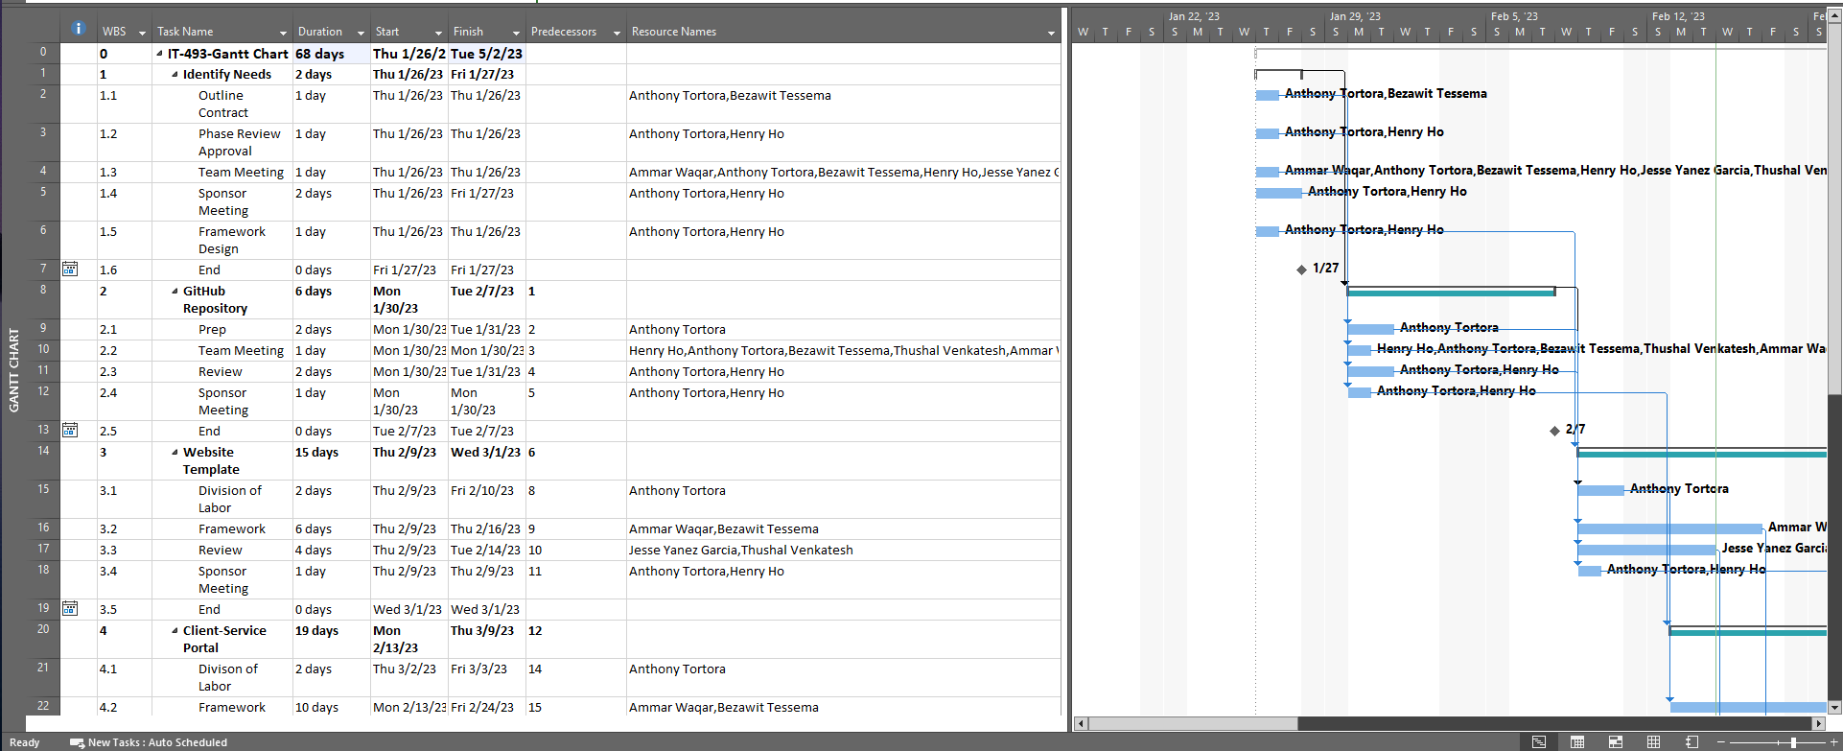
Project Schedule
Notes:
Estimated 70~ days to complete the project
Sponsor-Client meeting to achieve feedback and display alpha/beta phases of project
Front-End Team establish | Back-End Team establish, not shown on project schedule for clarity
The purpose of a milestone task is to provide a marker in the schedule. No work is done in a
milestone task as it merely indicates that a condition has been reached. Therefore, a milestone
task has 0 duration. We will use the property to designate which tasks in our schedule are
milestone tasks.
When we initially conceived our schedule, we placed a couple of tasks that we intended to be
milestone tasks. - HH

Slide 9
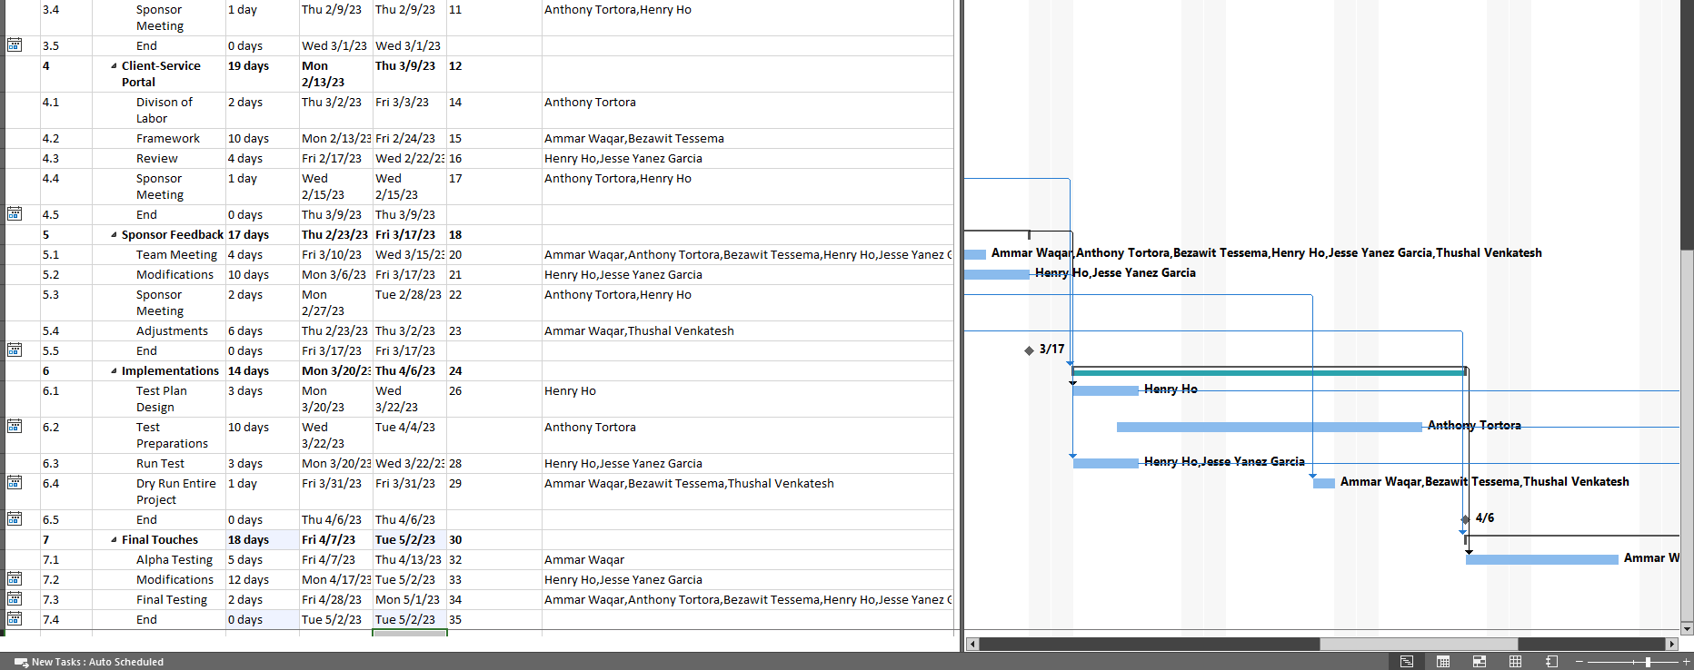
Project Schedule

Slide 10
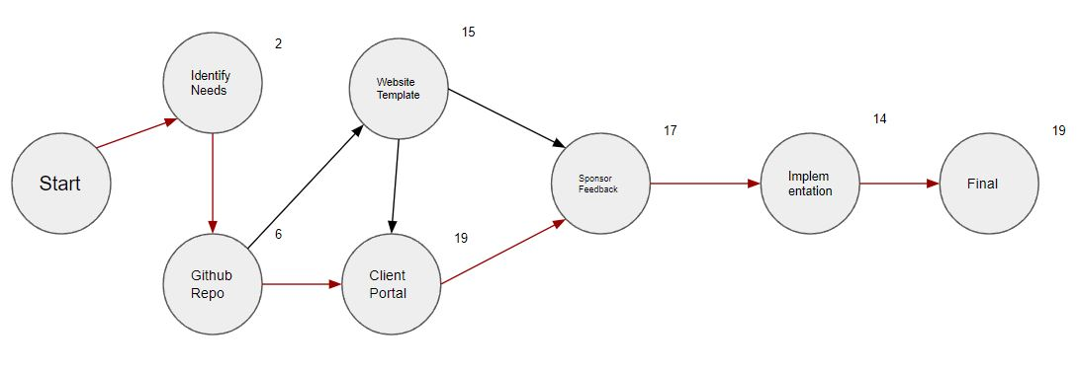
Critical Path and Project Dependencies
Notes:
77 day critical path, some of this has already been completed before the semester began
The creation of the repo is the first burst, allows the group to split into website template and client portal. The template itself is a burst as once the initial set up is complete the portal and initial feedback can begin as well
The portal is the first merge, as it requires some portion of the template to be completed before basic functionality can be developed. Sponsor feedback is the major merge as we’ll be taking feedback from on the site template and functionality from the portal to proceed to final implementation

Slide 11


Critical Path and Project Dependencies
Critical Path of 77 days
Longer than actual WBS projection, work was completed previous to the semester to meet deadlines
Burst Activities: Creation of GitHub Repository, Website Template
GitHub initialization is initial burst that allows for the Website Template and Client Portal
The Website Template does not be completed to burst into the Client Portal and Feedback but a baseline prototype does need to be roughed in
Merge Activity: Sponsor feedback
All previous activities need some sort of of baseline completion before feedback will be sought, once that minimum functionality met we will begin moving toward final implementation.

Slide 12

Team Assignment
4- Jesse: Software Development
5- Thushal: Risk Management Plan and Risk Register
6- Henry: Test Plan/ Test Scripts
7- Ammar: Quantification Plan
8- Beza: Training Plan and Materials
Notes:
Front-End Team: Jessie Yanez Garcia (Leading) → Thushal, Beza and Ammar
Back-End Team: Tony & Henry

Slide 13
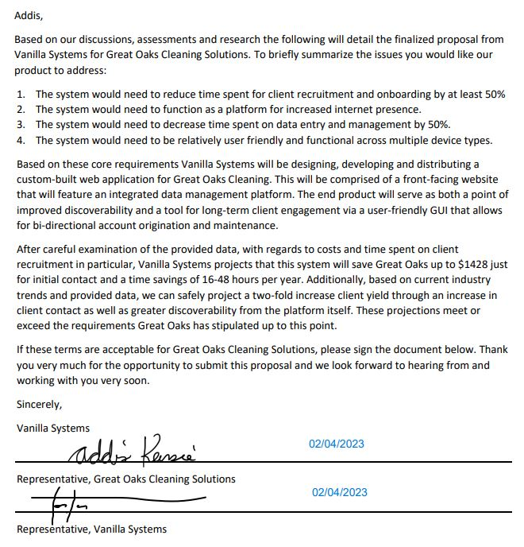

Approval

